Slide 1
IETF117 Hackathon : OPUS / WebRTC
Analyse and integrate
Deep Audio Redundancy (DRED) Extension in Opus in Gstreamer
Altanai B (23 July 2023)
Affiliation : Cisco Meraki

Slide 2
For use case of spike in loss ( heavy jitter ) such as burtsy network which could be a result of NAT rebinding or network handover, the audio codec needs to be resistant to heavy loss. One way is to overcome the missing data by synthetically reconstructing long sequences of lost packets.
This is achieved by Deep REDundancy (DRED)
which works by adding side information inside the regular Opus packets. OPUS is the default WebRTC audio codec.
More explanation: https://www.amazon.science/blog/neural-encoding-enables-more-efficient-recovery-of-lost-audio-packets

Slide 3
Aim of this hackathon project:
To analyse Deep Audio Redundancy (DRED) Extension for the Opus Codec via PSEQ and waveform on large Voice dataset
Implement the Coder and Decoder change in Gstreamer base plugin implementation of OPUS
draft-valin-opus-dred-01
https://datatracker.ietf.org/doc/draft-valin-opus-dred/

Slide 4
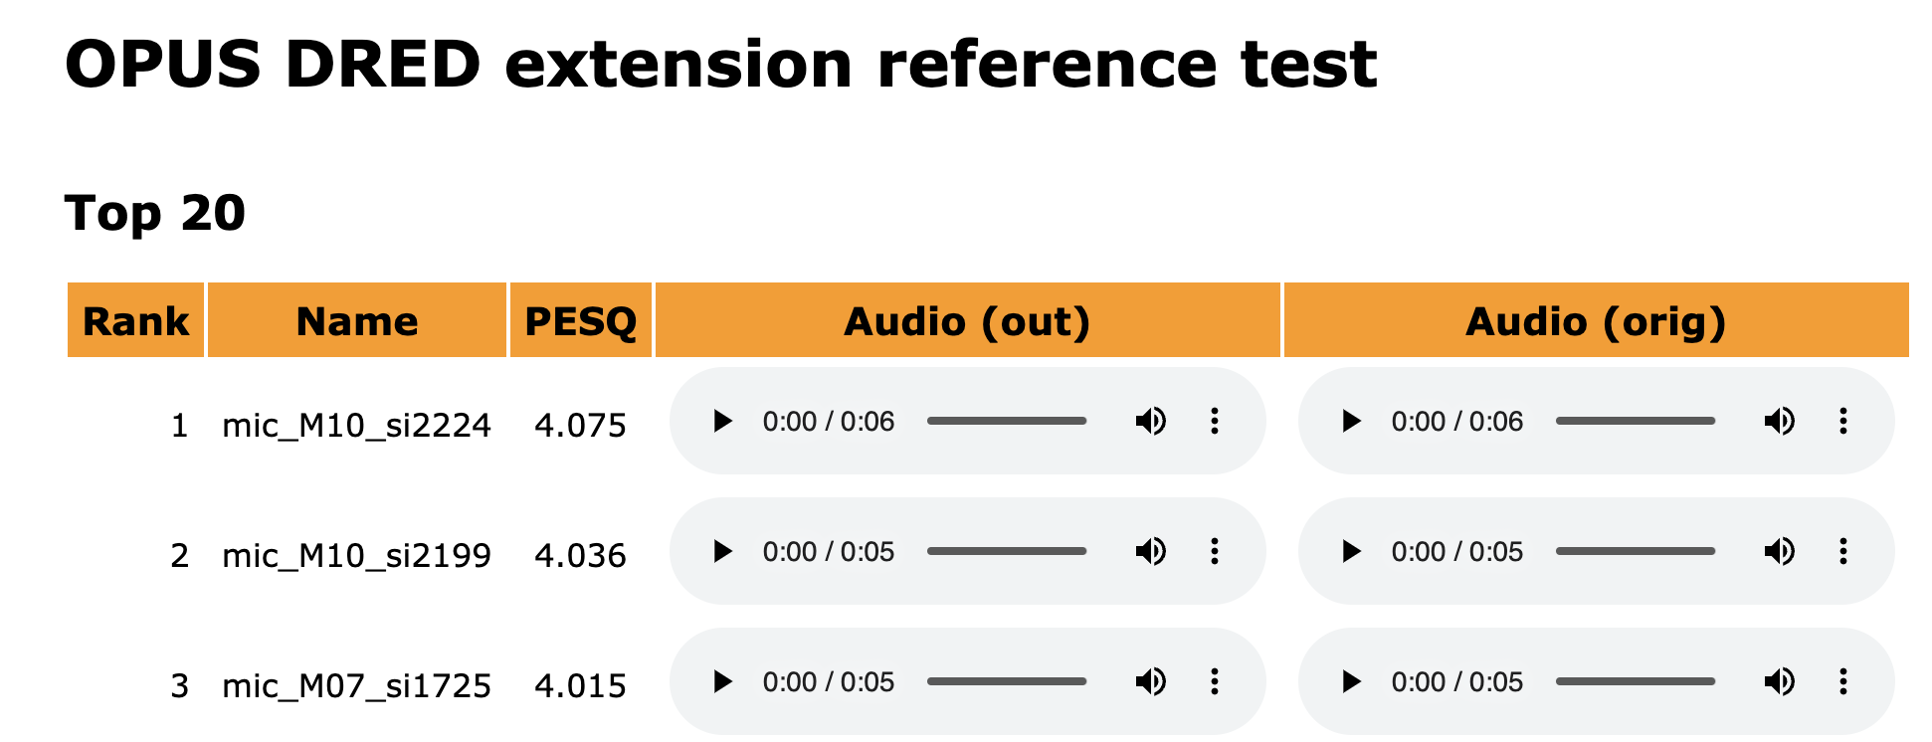
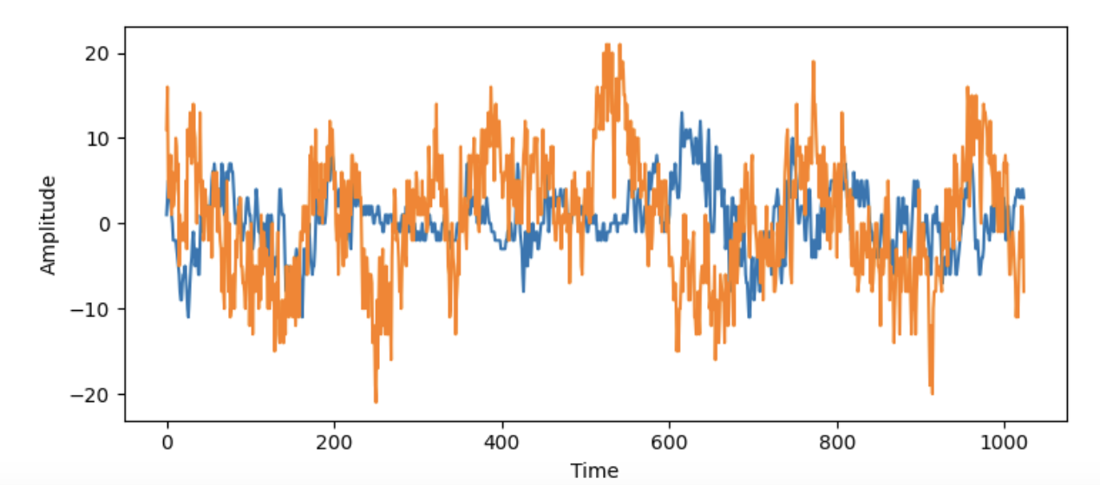
To analyse Deep Audio Redundancy (DRED) Extension for the Opus Codec via PESQ and waveform
DataSet: PTDB-TUG size:4GB source: https://www2.spsc.tugraz.at/databases/PTDB-TUG/
Tool Used : lpcnet-testsuite
https://gitlab.xiph.org/xiph/opus/-/tree/opus-ng/dnn/torch/testsuite
Jupyter notebook : https://github.com/altanai/IETF117-OPUS-APPLICATION/blob/main/AudioWaveform_OPUS-ng.ipynb

Slide 5
Encoder.c :Set OPUS_SET_DRED_DURATION as 1s and loss percentage to 20%
Also add changes to header file
2. POC for Coder and Decoder change in Gstreamer plugins-base implementation of OPUS for DRED
Gst Server
OPUS encoder with DRED
Gst client
OPUS decoder with DRED
Decoder Changes : monitor Seq number for loss and invoke opus_dred_parse params
OpusDREDDecoder ,
OpusDRED,
data,
len,
max_dred_samples,
sampling_rate,
defer_processing flag

Slide 6
Wrap Up
Altanai B (altanai@outlook.com)
Cisco Meraki
DRED IETF draft: https://datatracker.ietf.org/doc/draft-valin-opus-dred/
Hacathin repo (work in progress ) https://github.com/altanai/IETF117-OPUS-APPLICATION
Source Code of the OPUS codec with DRED extension https://gitlab.xiph.org/xiph/opus/-/tree/opus-ng?ref_type=heads
Gstreamer (work in progress - incomplete ) https://github.com/altanai/gst-build

